Slide 1
Gender Equity Activities in the DOE Office of Science
Linda G. Blevins, Ph.D.
Office of the Deputy Director for Science Programs
Women in Science and Engineering Workshop
November 16, 2009
Thomas Jefferson National Accelerator Facility
Newport News, VA

Slide 2
DOE Office of Science
The mission of the DOE Office of Science is to deliver the scientific discoveries and major scientific tools that transform our understanding of nature and advance the energy, economic, and national security of the United States.
The mission is accomplished by funding
Science for Discovery
Science for National Need
National Scientific User Facilities
FY10 Budget is $4.9B; supports ~25,000 people
Seven program offices
Advanced Scientific Computing Research (ASCR)
Biological and Environmental Research (BER)
Basic Energy Sciences (BES)
Fusion Energy Sciences (FES)
High Energy Physics (HEP)
Nuclear Physics (NP)
Workforce Development for Teachers and Scientists (WDTS)

Slide 3
The Workshops

Slide 4
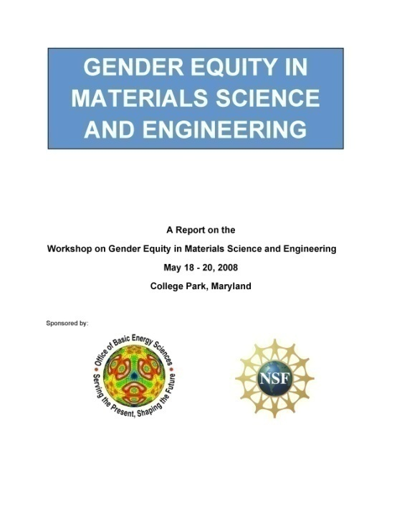
The Office of Science has co-sponsored 4 equity workshops.
Physics Gender Equity
DOE and NSF
May 2007
Materials Science Gender Equity
DOE and NSF
May 2008
Chemistry Gender Equity
DOE, NSF, and NIH
January 2006
Chemistry Racial and Ethnic Equity
DOE, NSF, and NIH
September 2007

Slide 5
The workshops educated us about implicit bias.
Data-driven, objective presentations by social scientists illuminated the concept of implicit bias.
Most men and women exhibit unintended bias.
https://implicit.harvard.edu/implicit/
“Gender schemas” are hidden assumptions about a person’s behavior based on gender.
Disadvantage (or advantage) can accumulate over time and impact the rate of advancement.
“Mountains are molehills, piled one on top of the other” -Virginia Valian, Hunter College
A particular challenge is to raise awareness of and tackle implicit bias in the laboratory.

Slide 6
Toolkit – Crosscutting Workshop Recommendations
Make diversity a priority at the highest levels of management
Strengthen documentation and enforcement of policies
Increase the percentage of women in job applicant and interview pools
Advertise broadly defined positions; begin recruiting early; consider nontraditional career paths; diversify search committees
Strengthen mentoring of early career scientists
Consider feedback from an early career committee
Develop a written mentoring plan and hold mentors accountable
Educate scientists
On implicit bias and accumulation of disadvantage: use data-driven presentations
On meeting facilitation; management best practices; interviewing rules
Schedule meetings that don’t interfere with family time
Develop policies for dual career couples
e.g., provide funds for spousal hires; split or share positions; creative recruiting and retention
Appreciate and advocate for child care facilities
Stop the tenure clock, stigma-free
Nominate women for leadership positions and awards; invite them for technical seminars
Provide equitable recognition when they get awards
Professional groups should certify institutions as “family friendly” or “gender equivalent”

Slide 7
Communities have followed up on their workshops.
All workshops used quantitative pre- and post-workshop surveys and found immediate attitude changes.
Chemistry chairs committed to two action items apiece at the end of the gender equity workshop.
42 of the 56 chairs have reported back in writing each year via secure website
Nearly four years have passed since the workshop, and the chairs still touch base
University Materials Council is keeping gender equity on the front burner.
Chairs meet at regular intervals and actively work together
Chairs report in writing specific examples of how they are already implementing many of the recommendations
Have formed a committee to explore “family friendly” certification
For the physics chairs, the American Physical Society is conducting follow-on site visits.

Slide 8
The DOE National Laboratories

Slide 9
The DOE and NNSA National Laboratories
Ames Laboratory
Argonne National Laboratory
Brookhaven National Laboratory
Fermi National Accelerator Laboratory
Idaho National Laboratory (NE)
Thomas Jefferson National Accelerator Facility
Lawrence Berkeley National Laboratory
Lawrence Livermore National Laboratory (NNSA)
Los Alamos National Laboratory (NNSA)
National Energy Technology Laboratory (FE)
National Renewable Energy Laboratory (EERE)
Oak Ridge National Laboratory
Pacific Northwest National Laboratory
Princeton Plasma Physics Laboratory
Sandia National Laboratories (NNSA)
Savannah River National Laboratory (EM)
SLAC National Accelerator Laboratory

Slide 10
DOE national labs operate under M&O contracts.
Management and Operating (M&O) contract
an agreement under which the Government contracts for the operation, maintenance, or support, on its behalf, of a Government-owned or -controlled research, development, special production, or testing establishment wholly or principally devoted to one or more major programs of the contracting Federal agency. (from the Federal Acquisition Regulation or FAR).
The FAR recognizes the special nature and need for M&O contracts.
Under this statutory contracting model, DOE directs the subject matter areas in which the contractors are focused and the overall performance objectives to be accomplished.
However, the contractors are relied upon to apply best management, scientific, and business practices in carrying out that direction.
DOE is the only Federal agency that uses M&O contracts.
As of 2007, DOE’s M&O contractors had about 100,000 employees compared to DOE’s roughly 14,000.
There are 17 DOE and NNSA national labs, each owned by the Government but operated by an M&O contractor.

Slide 11
The labs are, in some ways, different.
The workshops, while they have included labs, have focused largely on the academic environment.
While both universities and labs have scientific research cultures, the labs are structurally different.
Not organized into disciplinary units with department chairs.
Groups, divisions, directorates, branches, etc…with various disciplines represented among 10s to 100s of scientists.
There is no rank- and scope-equivalent chair with oversight for a scientific discipline.
Promotion and advancement processes do not necessarily or uniformly map onto academic tenure.
No single model applies for all national laboratories.
In recent years, a resource “toolkit” for gender equity has evolved for the academic community.
Tenure plays an important role.
There is no analogous toolkit for labs.

Slide 12
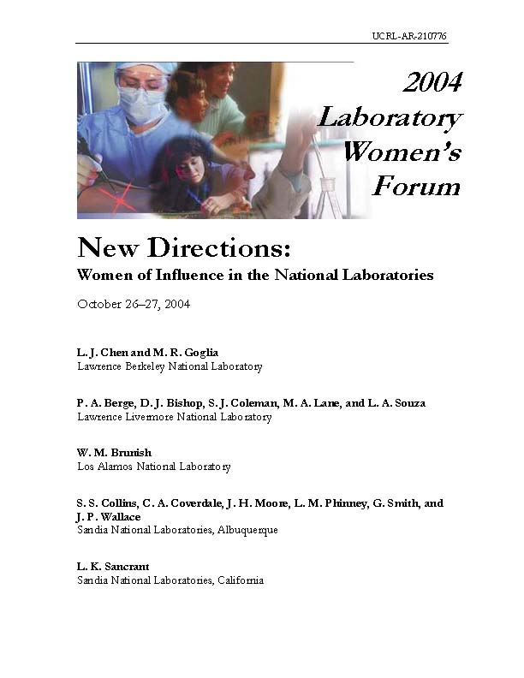
The labs are, in some ways, the same.
Blocks to attractiveness of lab careers
No mentoring or career development
Lack of ability to handle dual-career couple issues
Inadequate attention to child care
No time and workplace flexibility
Lack of transparency (secrecy about how things work)
Unwelcoming environments
Funding Issues
Lack of mentoring (“Women tend to flounder their first couple years at the Lab”)
It seems to take luck to fall into the “right” place early
Mentality that you don’t grow, that you are what you were when hired
Difficulty of gaining individual recognition in a team environment
Managers’ skills are poor or the wrong people become managers
Leaders not encouraging advancement of women and minorities
Negative perception of Laboratories, lack of understanding of science
Need for visible female role models and a critical mass
Maternity leave policies vary from one Lab to another
Restrictive policies regarding foreign nationals as staff, students, or postdocs
Can’t maintain visibility when doing classified work

Slide 13
Brookhaven National Laboratory (BNL) Family Friendly Policy Committee
BNL representatives attended chemistry and physics gender equity workshops.
In 2007, they formed the BNL Family Friendly Policy Committee.
The committee represents a cross-section of employees and reports to the lab director.
Charge: To examine current BNL “family friendly” policies and develop recommendations for improvement.
BNL already had existing family friendly policies:
adoption assistance, domestic partner benefits, scholarships for children of employees, flexible spending accounts for medical and dependent care, sick family member leave, on-site Child Development Center for babies and pre-schoolers, summer camp for employees’ children up to 14, an annual summer camp exposition, housing assistance — and more.
A few examples of policies proposed to the lab director: (*implemented so far)
Implement flexible work schedules*
Extend summer camp hours *
Enlarge the Child Development Center
Formulate a “Children at Work” policy
Provide additional paid leave after childbirth or adoption
Extend sick family member leave from 8 hours to 40 hours per year*
Extend further benefits for domestic partners*
Increase financial assistance for adopting a child*
The Family Friendly Policy Committee is now a standing committee.

Slide 14
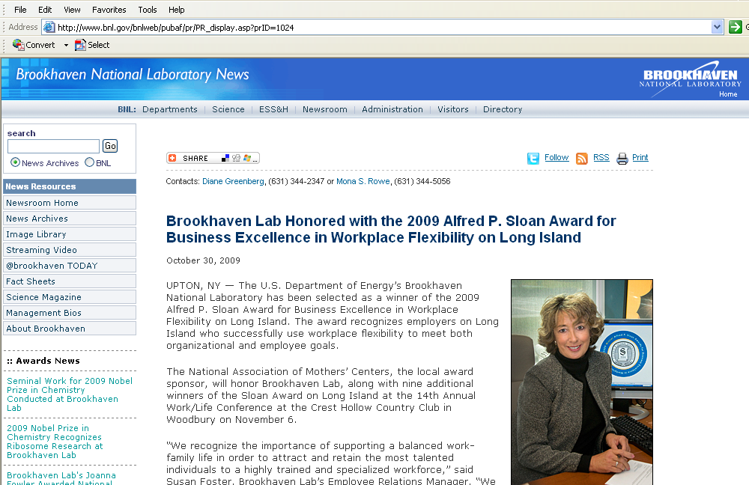
Congratulations to Brookhaven

Slide 15
The Agency

Slide 16
The workshops yielded suggested agency action items.
Train reviewers and grantees on diversity issues.
Modify peer review processes where necessary to ensure gender equity.
Foster gender equity in highly visible Federal programs such as national labs, large research centers, and prestigious awards.
Set clear guidelines for program managers on building diversity and ensure that these values are incorporated in the award process.
Support workshops and other activities to promote diversity and to monitor progress on gender equity.
Appoint women to review panels and advisory committees.
Re-tool grants for people returning after a short absence.
Fund additional post-docs to keep a lab active during family leave.
Encourage universities to support family leave options for grad students.
Ensure that childcare needs do not prevent attendance at professional meetings.
Create programs that enable early-career women to establish research programs leading to tenure and involve them as reviewers.
Collect data on gender and minority status in funding support. These data should be aggregated and made publicly available.

Slide 17
This is the inaugural year of the Early Career Research Program.
Purpose: To support the development of individual research programs of outstanding scientists early in their careers and to stimulate research careers in the disciplines supported by the Office of Science.
Principal investigators are within 10 years of receiving a Ph.D. and are either untenured academic assistant professors on the tenure track or full-time DOE national laboratory employees.
About 65 awards expected in FY10 with $85M in Recovery Act funds. Future annual competitions will be supported through regular research appropriations.
University grants are at least $150,000 per year for five years to cover summer salary and expenses; Lab awards are at least $500,000 per year for five years to cover full annual salary and expenses.
Announcements posted 7/2/09; ~2200 Letters of intent arrived by 8/3/09; ~1750 full proposals arrived 9/1/09; Announcements expected by 2/1/09.
Research will be competitively awarded based on peer review. Review and award management will take place in the six science programs.
Eligibility criteria, review criteria, and program rules are common across the Office of Science.
Frequently Asked Questions posted on http://www.science.doe.gov/sc-2/early_career.htm

Slide 18
We are working to obtain data.
Portfolio Analysis and Management System:
Core database with flexibility to add data manipulation modules
Exchanges data with existing systems
Allows direct data input from outside and inside DOE
Proposal record
Electronic proposal from a lab or university
Correspondence
Reviews and review information
Documentation of decision
Post-award management documents
Various metadata
People record
Information about reviewers and principal investigators
Contact information; optional demographics; keywords; proposal/review history

Slide 19
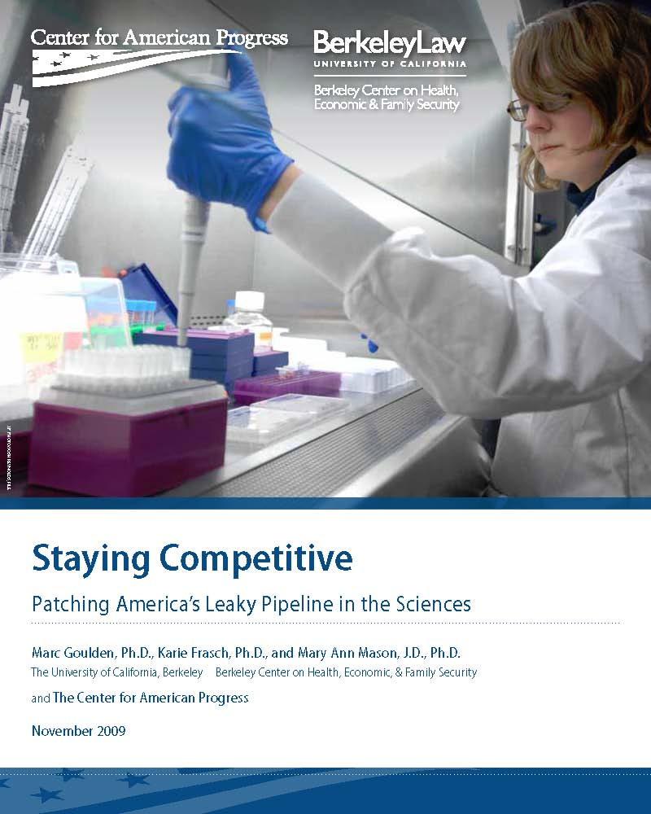
A new study suggests a stronger role for Federal agencies.
“Gender equity workshops, formalized policy statements about pipeline issues, and promises to support diversity in the science pipeline are important steps toward patching the leaks in the pipeline. Researchers at all levels will take notice if all federal granting agencies provide information, training, and materials on these issues. But they need to be followed up with tangible initiatives that actually promote diversity. Specifically, the agencies should actively model baseline family responsive policies and work toward a suite of additional offerings that help to support scholars with career-life issues throughout their academic career.”

Slide 20
Thank You
linda.blevins@science.doe.gov

Slide 21
Download the workshop reports.
Chemistry Gender Equity:
Co-Chairs: Cynthia Friend (Harvard) and Kendall Houk (UCLA) http://chemchairs.uoregon.edu
Physics Gender Equity:
Co-Chairs: Nora Berrah (Western Mich.) and Arthur Bienenstock (Stanford) http://www.aps.org/programs/women/workshops/gender-equity
Chemistry Racial and Ethic Equity:
Co-Chairs: Nicholas Turro (Columbia) and Isiah Warner (LSU) http://chemchairs.uoregon.edu
Materials Science and Engineering Gender Equity:
Co-Chairs: Angus Rockett (UIUC) and Ian Robertson (UIUC) http://www.matse.illinois.edu/gender/index.htm

Slide 22
